Slide 1
Advanced Trees
Red-Black Trees and Spatial Trees
Programming – Code Design & Data Structures

Slide 2
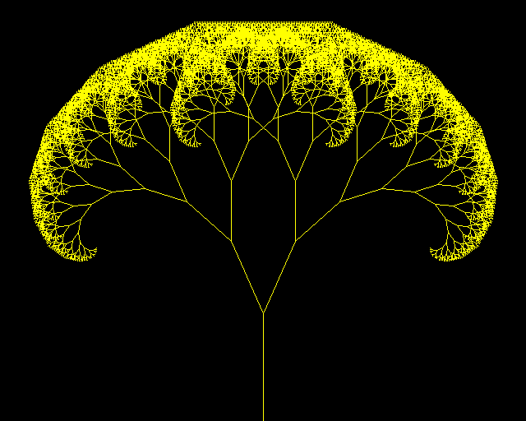
Contents
Types of Trees
Red Black Trees
Spatial Trees
Quadtrees
BSP Trees
K-D Trees
Octrees

Slide 3
Types of Trees
There are a lot of different types of trees and they are all suited to different tasks
2-3 Trees – Each node has either 1 value and 2 branches or 2 values and 3 branches
AB Trees – Where all leaves are at the same depth
B Trees – Each node has 2 or more children, often used in databases and filesystems
Dancing Trees – A form of self-balancing tree
Interval Trees – Each node contains a range of numbers. (e.g. 3 to 7)
Cartesian Trees – The root contains the lowest value and nodes are arranged in the order they are added
Splay Trees – A binary tree where the most recently accessed nodes are the fastest to access again
…and many more

Slide 4
Red-Black Trees
Red-Black trees are a self-balancing form of binary tree
The aim is to minimise how unbalanced the tree can become and so make it more efficient to search
They are constructed like normal binary trees, except that each node contains an additional piece of data: its colour, usually described as red or black
We use the node’s colour to help rebalance the tree
Red-Black trees are not perfectly balanced but usually considered “good enough”

Slide 5
Red-Black Trees - Rules
The root node is always black.
10
7
13
5
8
12
16
3
15
18
null
null
null
null
null
null
null
null
null
null
null

Slide 6
Red-Black Trees - Rules
All ‘leaves’ (null pointers) are considered black no matter the colour of their parent.
10
7
13
5
8
12
16
3
15
18
null
null
null
null
null
null
null
null
null
null
null

Slide 7
Red-Black Trees - Rules
The children of red nodes are always black.
10
7
13
5
8
12
16
3
15
18
null
null
null
null
null
null
null
null
null
null
null

Slide 8
Red-Black Trees - Rules
All paths from a node to its descendants’ leaves contain the same number of black nodes.
10
7
13
Here all the paths from the 13 node are shown in blue and the number of black nodes counted.
Each path has exactly the same number of black nodes: 2 (counting the null leaf as a node).
5
8
1
12
16
1
2
2
18
3
15
null
null
null
null
null
2
2
2
2
null
null
null
null
null
null

Slide 9
Balance
These properties keep the Red-Black tree roughly balanced since:
No path can ever have two red nodes in a row
No path can have more black nodes than any other path
Which means at most a path can only be twice as long as another path
e.g. a path of 2 black nodes compared to a path of 2 black nodes and 2 red nodes

Slide 10
Performance
Significantly more efficient than a normal binary search tree:
Binary Tree Search: O(n)
Red-Black Tree Search: O(log(n))

Slide 11
Insertion
New nodes are inserted just like in a binary tree except that the node starts red
Once the node has been inserted, nodes can be repositioned or recoloured to keep the rules and the balance of the tree intact
The algorithm itself is beyond the scope of this lesson
We can watch it here:
https://www.cs.usfca.edu/~galles/visualization/RedBlack.html

Slide 12
Spatial Trees
Spatial Trees are used to describe physical space in a tree structure
Used for physics calculations, AI, rendering, or even just to work out how close two objects are to one another
Very useful in games: Imagine the player has just thrown a grenade and we need to damage all enemies caught within its blast
We could test against every enemy in the level to see how far away they are but this could be very expensive if there are a lot of enemies
A spatial tree allows us to narrow down our search first to just those enemies that are roughly in the same area as the explosion, and then perform more precise checks against them

Slide 13
The problem…
The green diamond throws a grenade (yellow circle)
How many of the red enemies are inside the blast?
We could check all of them, but that’s expensive

Slide 14
Spatial Trees
The most common types of spatial trees are:
Quadtrees
Fairly easy to implement and good for top-down or 2D games
e.g. RTS games, retro RPGs, etc
Binary Space Partition Trees (BSP Trees)
Used in a lot of old famous FPS games (Unreal, Quake, Half-Life, Portal, etc)
Not used as much now
Octrees
Good for when objects are clustered in 3D space
e.g. space games, games where height is as important as width and length
K-D Trees
A hybrid of BSP and Quad trees

Slide 15
Quadtrees
First we treat the level as a giant square and add that to our tree as the root node
R

Slide 16
Quadtrees
Then we divide the level into four large squares (quads), and each of these is added as a child of the root
R
A
B
A
B
C
D
C
D

Slide 17
Quadtrees
Then we divide each quad into four more squares, and each of these is added as a child of its parent quad
R
A
B
1
2
1
2
A
B
C
D
3
4
3
4
1
2
3
4
1
2
3
4
C
D
1
2
1
2
3
4
3
4
1
2
3
4
1
2
3
4

Slide 18
Quadtrees
Then we add our enemies as nodes below the square they are in
R
A
B
1
2
1
2
A
B
C
D
3
4
3
4
1
2
3
4
1
2
3
4
C
D
1
2
1
2
3
4
3
4
1
2
3
4
1
2
3
4

Slide 19
Quadtrees
Now when the player throws a grenade…
We traverse the tree:
We check the position of the explosion against the four largest quads (A, B, C, D) and find it’s in A
Then we check against the four child squares and find it’s in square 4
Now we only need to check the position of enemies in quad A4
Much better than checking against all enemies in the level!
A
B
1
2
1
2
3
4
3
4
C
D
1
2
1
2
3
4
3
4

Slide 20
Quadtrees
But we can do better!
Notice how some of the squares don’t contain enemies, those are wasting space!
A
B
1
2
1
2
3
4
3
4
C
D
1
2
1
2
3
4
3
4

Slide 21
Quadtrees
Instead of dividing the quads up regularly, we can divide them based on the number of objects inside them
As more objects are added, we divide each square more and more

Slide 22
Quadtrees
This is called an adaptive quadtree
In this example there is no more than one enemy per quad but you can design it to support more
Very efficient to search

Slide 23
Quadtrees - Conclusion
Advantages:
Very efficient representation of spaces containing unevenly distributed objects
Relatively simple algorithm
Used in many games for scene graphs
Theoretical maximum search time is O(log n)
Disadvantages
Finding a neighbouring cell can be time consuming
Implementation can lead to fragmentation of memory
Cache coherency problems
Creating balanced trees is tricky so theoretical speeds are rarely reached in practice

Slide 24
Binary Space Partitioning Trees (BSP Trees)
Splits space in two, usually along walls or other physical planes in the game
Uses a binary tree to position all objects on one side of the split in one branch and those on the other side in the other
Repeats this process over and over to build the tree

Slide 25
BSP (Binary Space Partitioning) Trees
Consider again this problem…

Slide 26
BSP (Binary Space Partitioning) Trees
Again we treat the level as the root node
R

Slide 27
BSP (Binary Space Partitioning) Trees
Then we split the space in two and make each area a branch in our binary tree
Normally we would split along physical geometry, like a wall or other obstruction the player can’t see through
R
A
A
B
B

Slide 28
BSP (Binary Space Partitioning) Trees
Then we split along another plane and add the split spaces to our tree
R
A
A
B
A1
A2
B1
B2
A2
A1
B2
B1
B

Slide 29
BSP (Binary Space Partitioning) Trees
And so on… splitting and adding to the tree…
R
A
F1
E1
F2
A
B
D2
E2
D1
C2
A1
A2
B1
B2
A2
C1
A1
D1
D2
C1
C2
B2
B1
E1
E2
F1
F2
B

Slide 30
BSP (Binary Space Partitioning) Trees
Then we add our enemies as leaves on the tree based on which side of each line they fall on
R
A
F1
E1
F2
A
B
D2
E2
D1
C2
A1
A2
B1
B2
A2
C1
A1
D1
D2
C1
C2
B2
B1
E1
E2
F1
F2
B

Slide 31
BSP Tree - Conclusion
Advantages:
Works well in enclosed spaces where the area is naturally split by level geometry
The plains can be oriented in any direction and with any origin so spaces can be efficiently divided up
Algorithm is fairly simple
Disadvantages:
Quite slow to compute
There is no right or wrong way to choose splitting planes so more sophisticated algorithms spend a lot of time trying to create balanced trees
Doesn’t work well for large open spaces
Better methods have been found so not used very often these days

Slide 32
K-D Trees
Best thought of as a hybrid of BSP and Quad Tree
Space is repeatedly split into two parts (like BSP tree)
But it is split along one of the axis
A different axis is used on each iteration (x, y, x, y, x, y... etc.)
Usually the median object in the list of objects is picked for the splitting plane

Slide 33
K-D Tree - Conclusion
Advantages:
Straightforward to generate
Easily creates a balanced tree
Very efficient
Disadvantages:
Finding neighbouring cells is complex (approximate search algorithms are often used to improve performance)
Does not work well in high dimensional spaces
Quad and Oct trees have largely replaced it

Slide 34
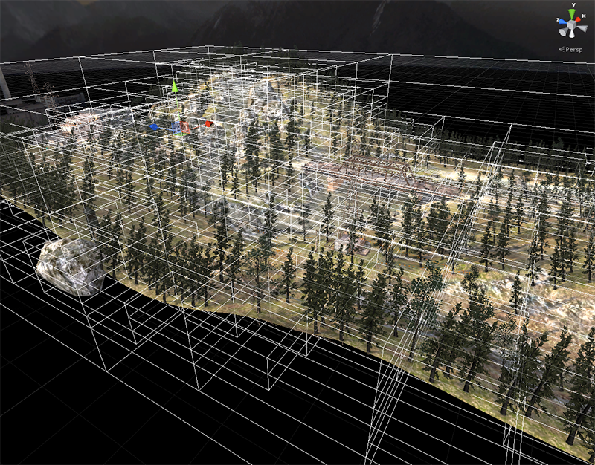
Octree
Works just like a quadtree, but in 3D
Not much harder to implement
Very efficient for partitioning 3D space

Slide 35
Summary
There are a lot of trees that were designed to solve a very specific problem
Red-Black trees are very efficient for searches
Quadtrees and Octress are very efficient for spatial partitioning
Use the tree that fits the situation

Slide 36
References
Sedgewick, R, Left-leaning Red-Black Trees, Department of Computer Sciece, Princeton University
https://www.cs.princeton.edu/~rs/talks/LLRB/LLRB.pdf
Samet, H & Webber, R, Storing a Collection of Polygons Using Quadtrees, University of Maryland & Rutgers Univeristy
http://www.cs.umd.edu/~meesh/420/Notes/PMQuadtree/pm_quadtree_samet.pdf
Shimer, C 1997, Binary Space Partition Trees, Advanced Topics in Computer Graphics
http://web.cs.wpi.edu/~matt/courses/cs563/talks/bsp/bsp.html

